Slide 1

Department of Computer Engineering
Sequential Logic Design – Truth Tables and Excitation Tables
1

Slide 2
Points covered
Department of Computer Engineering
Introduction
Flip flop, truth table and excitation table
JK to D Flip flops
T to D Flip flop
SR flip flop to JK flip flop
2

Slide 3
Department Vision & Mission
Department of Computer Engineering
Vision
Achieve academic excellence through education in computing, to create intellectual manpower to explore professional, higher educational and social opportunities.
Mission
To impart learning by educating students with conceptual knowledge and hands on practices using modern tools, FOSS technologies and competency skills there by igniting the young minds for innovative thinking, professional expertise and research.

Slide 4
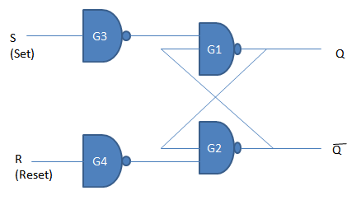
Department of Computer Engineering
SR FF
IF S=R=0 Circuit will be same state i.e. No Change.
IF S=1 & R=0 then Q=1
IF S=0 & R=1 then Q=0
IF S=R=1 , then both the outputs Q and Q̅ will try to become 1 which is not allowed and therefore this input condition is prohibited
(Race Condition).

Slide 5
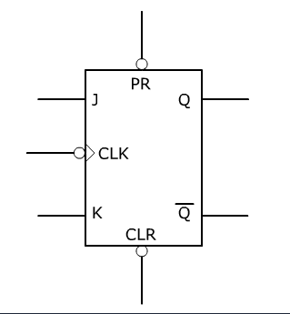
JK FF
Department of Computer Engineering
Used to avoid race condition which does occur in SR FF
It has 2 inputs named J & K.
It has two outputs Q & Q’.
One Clock signal.
2 Asynchronous inputs PR & CLR
Symbol of JK -

Slide 6
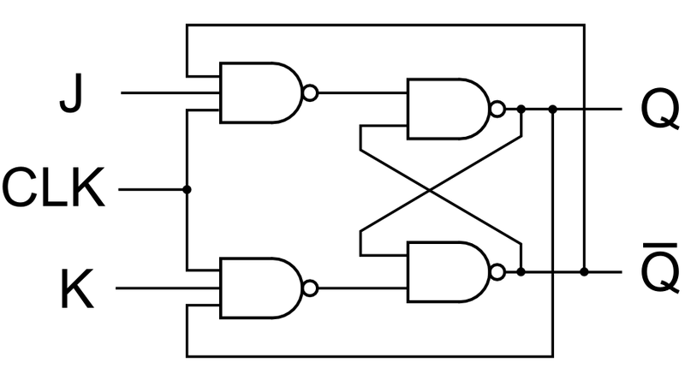
Department of Computer Engineering
JK FF Operation
The 4 modes of operation are: hold, set, reset, toggle
Truth Table of JK
J | K | Q | Q’ | Mode
0 | 0 | Q | Q’ | Hold
1 | 0 | 1 | 0 | Sets
0 | 1 | 0 | 1 | Resets
1 | 1 | Q’ | Q | Toggle

Slide 7
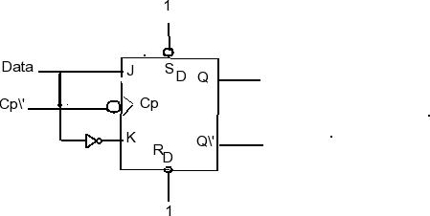
Department of Computer Engineering
D-Type Flip Flop
D – means Delay. The Q output always takes on the state of the D input at the moment of a rising clock edge.
The output takes the value of the D input or Data input, and Delays it by one clock count.
Truth Table
D | Q
0 | 0
1 | 1

Slide 8
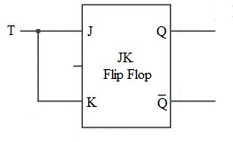
Department of Computer Engineering
T -Type Flip Flop (Toggle)
In J K Flip Flop , if J=K, the resulting Flip flop is referred to as a T- type Flip Flop.
Pr
T | Q
0 | Q
1 | Q’
Clk
Cr

Slide 9
Department of Computer Engineering
Excitation Tables
Two tables are there:-
Truth table:- shows operation of circuits i.e. shows changes in output whenever changes in inputs. Mapping between input to output.
Excitation table:- Sometimes there is need to find input condition from the given output conditions, we need excitation table. In this case for the desired output, we need to find out input conditions

Slide 10
Department of Computer Engineering
J K Flip Flop
JK truth table
Next state table
J | K | Qn+1
0 | 0 | Qn
0 | 1 | 0
1 | 0 | 1
1 | 1 | Qn’
J | K | Qn | Qn+1
0 | 0 | 0 | 0
0 | 0 | 1 | 1
0 | 1 | 0 | 0
0 | 1 | 1 | 0
1 | 0 | 0 | 1
1 | 0 | 1 | 1
1 | 1 | 0 | 1
1 | 1 | 1 | 0

Slide 11
Department of Computer Engineering
J K Flip Flop
JK truth table
JK excitation table
J | K | Qn+1
0 | 0 | Qn
0 | 1 | 0
1 | 0 | 1
1 | 1 | Qn’
Qn | Qn+1 | J | K
0 | 0 | 0 | X
0 | 1 | 1 | X
1 | 0 | X | 1
1 | 1 | X | 0

Slide 12
Department of Computer Engineering
S R Flip Flop
SR truth table
Next state table
S | R | Qn+1
0 | 0 | Qn
0 | 1 | 0
1 | 0 | 1
1 | 1 | ?
S | R | Qn | Qn+1
0 | 0 | 0 | 0
0 | 0 | 1 | 1
0 | 1 | 0 | 0
0 | 1 | 1 | 0
1 | 0 | 0 | 1
1 | 0 | 1 | 1
1 | 1 | 0 | ?
1 | 1 | 1 | ?

Slide 13
Department of Computer Engineering
S R Flip Flop
SR truth table
SR excitation table
S | R | Qn+1
0 | 0 | Qn
0 | 1 | 0
1 | 0 | 1
1 | 1 | ?
Qn | Qn+1 | S | R
0 | 0 | 0 | X
0 | 1 | 1 | 0
1 | 0 | 0 | 1
1 | 1 | X | 0

Slide 14
Department of Computer Engineering
D Flip Flop
D truth table
Next state table
D | Qn+1
0 | 0
1 | 1
D | Qn | Qn+1
0 | 0 | 0
0 | 1 | 0
1 | 0 | 1
1 | 1 | 1

Slide 15
Department of Computer Engineering
D Flip Flop
D truth table
D excitation table
Qn | Qn+1 | D
0 | 0 | 0
0 | 1 | 1
1 | 0 | 0
1 | 1 | 1
D | Qn+1
0 | 0
1 | 1

Slide 16
Department of Computer Engineering
T Flip Flop
T truth table
Next state table
T | Qn+1
0 | Qn
1 | Qn’
T | Qn | Qn+1
0 | 0 | 0
0 | 1 | 1
1 | 0 | 1
1 | 1 | 0
T excitation table
Qn | Qn+1 | T
0 | 0 | 0
0 | 1 | 1
1 | 0 | 1
1 | 1 | 0

Slide 17
Department of Computer Engineering
T Flip Flop
T truth table
T excitation table
Qn | Qn+1 | T
0 | 0 | 0
0 | 1 | 1
1 | 0 | 1
1 | 1 | 0
T | Qn+1
0 | Qn
1 | Qn’

Slide 18
Conversion of FF
Department of Computer Engineering
Identify available and required flip flop
Make characteristic table for required flip flop.
Make excitation table for available flip flop.
Write Boolean expression for available flip flop.
Draw the circuit.

Slide 19
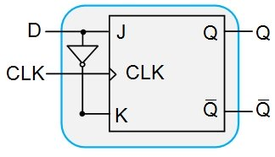
Conversion of JK to D Flip
Department of Computer Engineering
1) available flip flop - JK
required flip flop - D
2) D truth/characteristics table (required FF)
3) JK excitation table
Qn | Qn+1 | J | K
0 | 0 | 0 | X
0 | 1 | 1 | X
1 | 0 | X | 1
1 | 1 | X | 0
D | Qn+1
0 | 0
1 | 1
Write Boolean expression
D
Qn | D | Qn+1 | J | K
0 | 0 | 0 | 0 | X
0 | 1 | 1 | 1 | X
1 | 0 | 0 | X | 1
1 | 1 | 1 | X | 0
0
1
D
Qn
0
1
0
0
1
Qn
0
x
x
1
X
X
1
1
0
J=D
K=D’

Slide 20
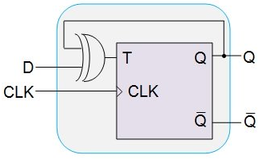
Conversion of T flip flop to D flip flop
Department of Computer Engineering
1) available flip flop – T
required flip flop - D
2) T truth/characteristics table (required flip flop)
3) T excitation table
Qn | Qn+1 | T
0 | 0 | 0
0 | 1 | 1
1 | 0 | 1
1 | 1 | 0
D | Qn+1
0 | 0
1 | 1
Write Boolean expression
D
Qn | D | Qn+1 | T
0 | 0 | 0 | 0
0 | 1 | 1 | 1
1 | 0 | 0 | 1
1 | 1 | 1 | 0
0
1
Qn
0
0
1
1
1
0
T=Q’ D + Q D’
= Q ⊕ D

Slide 21
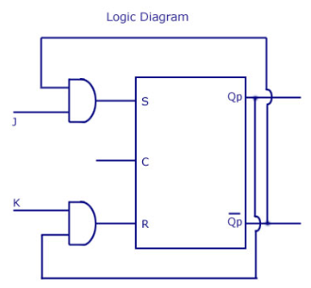
Conversion of SR flip flop to JK flip flop
1) available flip flop – SR
required flip flop - JK
2) T truth/characteristics table (required flip flop)
3) SR excitation table
J | K | Qn+1
0 | 0 | Qn
0 | 1 | 0
1 | 0 | 1
1 | 1 | Qn’
Qn | Qn+1 | S | R
0 | 0 | 0 | X
0 | 1 | 1 | 0
1 | 0 | 0 | 1
1 | 1 | X | 0
Write Boolean expression
Qn | J | K | Qn+1 | S | R
0 | 0 | 0 | 0 | 0 | X
0 | 0 | 1 | 0 | 0 | X
0 | 1 | 0 | 1 | 1 | 0
0 | 1 | 1 | 1 | 1 | 0
1 | 0 | 0 | 1 | X | 0
1 | 0 | 1 | 0 | 0 | 1
1 | 1 | 0 | 1 | X | 0
1 | 1 | 1 | 0 | 0 | 1
JK
Qn
00
01
11
10
0
0
0
1
1
S = Qn’. J
1
X
0
0
X
JK
Qn
00
01
11
10
0
X
X
0
0
R = Qn. K
1
0
1
1
0

Slide 22
JK- Flip Flop to T- Flip Flop

Slide 23
T Flip Flop to JK Flip Flop

Slide 24
Department of Computer Engineering
Thank you

